Slide 1
The Neural Network
Unit 2
MDS 655

Slide 2
Building Intelligent Machines
The Brain is, inherently, what makes us intelligent
Incredible organ
stores memories
experience emotions
Dream

Slide 3
Building Intelligent Machines (continued…)
Powerful than supercomputers
Face recognition
Discern discrete objects from their backgrounds
Can understand grammar
Enhancement of vocabulary

Slide 4
Building Intelligent Machines (continued…)
Intelligent machines are build by using brains
Robots
Disease detection
Automated vehicles

Slide 5
Building Intelligent Machines (continued…)
Building Intelligent machines is a challenge
Needs to solve Computational problems
Developing radically different way of programming
This leads to deep learning

Slide 6
The Limits of Traditional Computer Programs
Computer Programs are good only at
performing arithmetic really fast
explicitly follows a list of instructions

Slide 7
The Limits of Traditional Computer Programs
Brain can recognize every digits though are
drastically different
Programs find it difficult specially when the character is not complete

Slide 8
The Limits of Traditional Computer Programs (Continued…)
zero that’s algorithmically difficult to distinguish from a six
How to handle this situation?
Threshold level
cutoff value of distance to form a close loop
Infinite rules for every situation is not possible

Slide 9
The Limits of Traditional Computer Programs (Continued…)
We don’t know what program to write because we don’t know how it’s done by our brains
even if we did know how to do it, the program might be horrendously complicated.

Slide 10
The Mechanics of Machine Learning
h(x,θ)
X: vector
(pixel intensities
of gray scale image)
Θ: Vector of parameters
that model uses

Slide 11


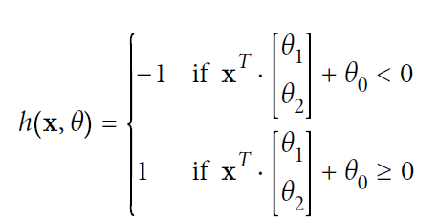
The Mechanics of Machine Learning (continued…)
x1: number of hours of sleep
x2 : number of hours of study
Parameters that is to be learned

Slide 12

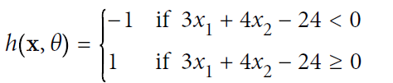
The Mechanics of Machine Learning (continued..)
Geometrically, this particular blueprint describes a linear classifier that divides the coordinate plane into two halves
This model is called Linear Perceptron

Slide 13
The Mechanics of Machine Learning (continued..)
Optimization of parameter θ is required
An optimal parameter vector θ positions the classifier correctly with less error
This is related to gradient descent

Slide 14
The Mechanics of Machine Learning (continued..)
As our data takes on more complex forms, we need more complex models to describe them

Slide 15
The Mechanics of Machine Learning (continued..)
Objects recognition, text analysis, image analysis, NLP, computer vision are complex problems
Extremely high dimensional
Highly non linear
Requires deep learning i.e. complex models to solve them !!!

Slide 16
The Neuron

Slide 18
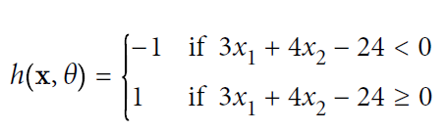


Slide 19
Feed Forward Networks
Information flows from
one layer to another
until sensory input is converted into conceptual
understanding.
Analogy to Brain
Bottom most layer visual inputs
The information flows to higher level
Sixth layer decides which object

Slide 20
Feed Forward Networks (continued…)
As we mentioned, the layers of neurons that lie sandwiched between the first layer of neurons (input layer) and the last layer of neurons (output layer) are called the hidden layers. This is where most of the magic is happening when the neural net tries to solve problems

Slide 21
Feed Forward Networks (continued…)
Although in this example every layer has the same number of neurons, this is neither necessary nor recommended. More often than not, hidden layers have fewer neurons than the input layer to force the network to learn compressed representations of the original input

Slide 22
Feed Forward Networks (continued…)
It is not required that every neuron has its output connected to the inputs of all neurons in the next layer. In fact, selecting which neurons to connect to which other neurons in the next layer is an art that comes from experience

Slide 23



Feed Forward Networks (continued…)
The inputs and outputs are vectorized representations
y

Slide 24
Activation Function

Slide 25
Activation Function (continued…)

Slide 26
Activation Function (continued…)

